Slide 1
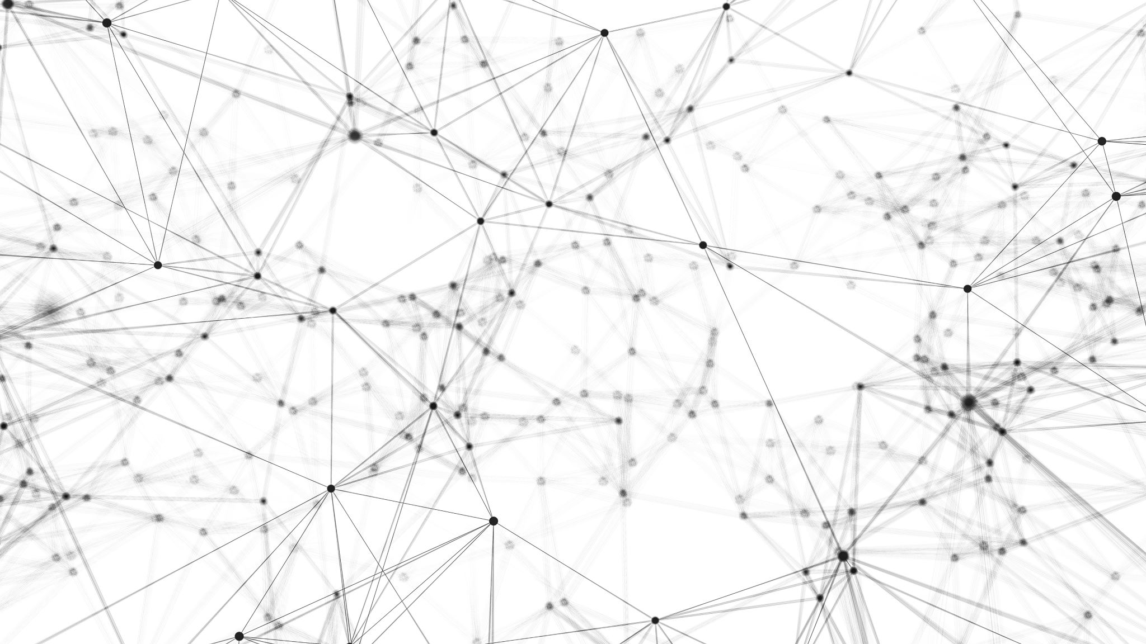
Introduction to AI, Spring 2023 Genetic Algorithms

Slide 2
Genetic Algorithms
A way to search inspired by Darwinian evolution and “Survival of the Fittest.”
Let’s just freshen up on what we mean by that…
Using a common evolutionary device: giraffes!
Notes:
So, watch out, there’s a little bit of a content warning on the next slide for anyone who loves giraffes.

Slide 3
Natural Selection
Notes:
The internet has lots of imagery of long necked giraffes just casually munching leaves amongst the corpses of their short necked bretheren.
They depict how out on the Afircan Savannah, a lot of the tasty leaves are on trees that might be hard to reach. Long necked giraffes are better able to eat that food, and thus better able to prevents themselves from starving to death. Though, er, apparently they aren’t particularly equipped with compassion.

Slide 4
Natural Selection
The basic premise: there are certain traits that help you to survive.
Like having a long neck to reach scarce resources.
Individuals that don’t have that trait are less likely to survive
Individuals that do have that trait are more likely to survive.
And fall in love…
And have kids…
Kids that *also* have that trait…
Who will eventually have more kids of their own…
Leading to that trait being very common.

Slide 5
Genetic Algorithms
This is the heart of genetic algorithms!
Just replace “Giraffe” with “state”!
Just as two giraffes make a baby that has traits like its parents…
Create a “baby” state who shares the traits of two “parent” states!
Notes:
And this exact same premise is what is going on with genetic algorithms! The big difference is that instead of working with giraffes, we are working with states!

Slide 6
Genetic Algorithms – Knowledge Representation
One of the trickier parts of using a Genetic Algorithm:
You need to be able to represent a state as String
And every possible state needs to be a String of the same length.
Frequently, this is a binary string (i.e., a bunch of 0s and 1s).
But doesn’t have to be!
Indeed, the example we see today won’t be.
Notes:
One part that require a little bit of brilliance or insight in order to use a genetic algorithm: you need to be able to represent the state as a String. And the String needs to be constructed in such a way that the String for every single possible state is the same length.
Also, often times these are binary strings (i.e., the Strings are just full of 0s and 1s), but as we’ll see in today’s example, this doesn’t need to be the case.

Slide 7
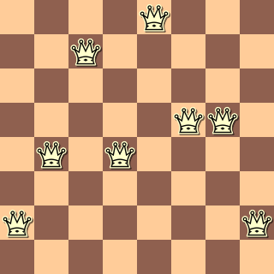
Knowledge Representation in 8 Queens
Returning once again to the 8 Queens problem…
What might be a nice way to represent board states as Strings?
Hint: What might a good length of these strings be?
Notes:
Let’s return to our old friend, the 8 queen problem again. What might possibly be a nice way to represent board states as Strings?
Hint: what might a good length for these strings be?
Double hint: what if I told you that 8 might be a good length?

Slide 8
Knowledge Representation in 8 Queens
Let’s say that each String is of length 8…
Let’s say that each character of the String is an integer between 1 and 8…
Let’s say that those integers correspond to the rows (Ranks) of the chessboard…
And that the positions of the characters represent the columns (File).
So the first character is the row the first queen is on, the second character is the row the second queen, etc.

Slide 9
Knowledge Representation in 8 Queens
8
7
6
5
4
3
2
1
So, how would we represent this board?
What would the first character of our String be?
????????
row far left queen is on

Slide 10
Knowledge Representation in 8 Queens
8
7
6
5
4
3
2
1
So, how would we represent this board?
First character corresponds to first column, that queen is on row 2.
What would the next character be?
2???????

Slide 11
Knowledge Representation in 8 Queens
8
7
6
5
4
3
2
1
So, how would we represent this board?
Second character corresponds to second column, that queen is on row 4.
24??????

Slide 12
Knowledge Representation in 8 Queens
8
7
6
5
4
3
2
1
So, how would we represent this board?
And the pattern continues…
Yielding a representation of:
24748552

Slide 13
Knowledge Representation in 8 Queens
8
7
6
5
4
3
2
1
And just for fun… what might be a way to represent this same board as a binary string?

Slide 14
Knowledge Representation in 8 Queens
8
7
6
5
4
3
2
1
00001000
Perhaps a string of length 64, one character for each square of the board.
0 means that there isn’t a queen there.
1 means that there is a queen there.
00100000
00000000
00000110
01010000
00000000
10000001
00000000

Slide 15
Fitness Functions
In “real life” natural selection, how were individuals deemed “good”?
They didn’t die! They lived long enough to reproduce!
In Genetic algorithms, we need a way of measuring the goodness of a state.
We do that with a fitness function.
Same idea as “objective function”, “evaluation function”, etc.
Should return higher values for better states.
Notes:
Hopefully this should sound familiar by now! We’ve been measuring the goodness of a state all over the darn place lately!
In Genetic algorithms, they tend to be called “fitness functions” – partly because they are leaning into the metaphor of Darwinian “survival of the fittest”, but also because, as we’ll see in a moment, because these functions work best when they are, in fact, measuring “goodness”, as opposed to say “cost”, i.e., the higher the value, the better the state.
But truly, conceptually its just yet another term that captures this same notion as objective function, evaluation function, etc.

Slide 16
Fitness Function for 8 Queens Problem
Returning to state 24748552…
What might be a way to evaluate how “fit” a state is?
Notes:
And again, with the lens of “fitness function”, we are looking for a way of giving a numeric score to how FIT it is, i.e., higher numbers are better. So this will need to be a different formulation than what we saw with the previous slide deck, where we found a way of measuring how lower numbers were better.

Slide 17
Fitness Function for 8 Queens Problem
We could say that it’s the number of non-attacking pairs of queens!
Kind of the inverse of the previous heuristic, since now we value ‘high fitness’ as opposed to ‘low cost’
There are 28 pairs total.
So any valid solution will have its evaluation function return 28.
This example has 24 non-attacking pairs, so the function would return 24.
24748552
Notes:
Basically, we could say its just the opposite of what we had before! Before we were measuring how many queens were attacking each other, and so the lower numbers were better, i.e., it means fewer queens are attacking.
Instead, we could just say that we are counting the number of pairs that AREN’T attacking each other! And now higher numbers are better!
You can take my word on this, but there are 28 pairs total (7+6+5+4+3+2+1), so with this fitness function, any “valid” solution will return 28.
This that I’m displaying right now is *not* a valid solution. Again, trust me when I say that it has 24 non-attacking pairs, so this state would evaluate of having a fitness of 24.

Slide 18
The General Genetic Algorithm
We now have everything that we need to rock and roll!
The basic premise:
Generate an initial population.
i.e., lots of individual states, represented in our String format.
Figure out how good each individual is in our initial population (weight them).
Using our fitness function.
If anything is a solution, then we are already done!
Select pairs of individuals to “mate” and produce offspring states
The ”fitter you are” the more likely you will mate
Mutate the offspring state
More on this later.
Replace the initial population with the new generation, and repeat until a solution is found!
Notes:
Armed with our knowledge representation and our fitness function, we can now go over the general genetic algorithm! We’re going to present it as a series of steps.
1.) We generate an initial population, i.e., we create a bunch of states, represented in our string format.
2.) Step two is then running each member of that population through our fitness function. And note, we aren’t just interested in the absolute score of any given state (e.g., this score is a 24, this score is an 18), but we are interested in finding just how good they are *relative* to the other members of the population. i.e., we are weighting them.
3.) We then play Cupid, and select pairs of states to “mate” and produce offspring states, with the likelihood any given state will have to mate be based off of that “weighted fitness” we figured out from the previous step.
4.) We then do something that we haven’t really talked about yet, but that also happens in nature all the time: genetic mutation. We’ll chat about that more in a bit.
5.)And then, finally, you treat all of these offspring states as if they are the new generation, and you repeat this process again, until a solution is found!

Slide 19
The General Genetic Algorithm - Pseudocode
Generate an initial population.
Loop:
If an individual is a solution, succeed.
Weight each individual by fitness.
Select (by weight) some pairs to mate.
Mate the pairs.
Mutate each new individual.
Replace the population with offspring.
Notes:
And so here’s all of that as pseudocode!

Slide 20
Genetic Algorithm Example – 8 Queens
Step 1: Generate an initial population.
24748552
32752411
24415124
32543213
Notes:
So, you know, we somehow generate an initial population. Maybe we just did this totally randomly (i.e., produce X Strings of length 8, where each character is a number between 1 and 8)

Slide 21
Genetic Algorithm Example – 8 Queens
Step 2: Evaluate and weight each individual based on fitness function
24748552
32752411
24415124
32543213
Notes:
And now that we have our population, we need to evaluate and weight each individual based off of our fitness function. So again, we’re saying that we have a function that is capable of taking in a state and returns as output the total number of non-attacking pairs of queens. So let’s say that we do that…

Slide 22
Genetic Algorithm Example – 8 Queens
Step 2: Evaluate and weight each individual based on fitness function
24748552 has 24 non-attacking pairs
32752411 has 23 non-attacking pairs
24415124 has 20 non-attacking pairs
32543213 has 11 non-attacking pairs
Notes:
And we end up with this – and how convenient, they just happened to be arranged so that they were all sorted nicely. This first state had 24 non-attacking pairs, the next one 23, then 20, and then 11.

Slide 23
Genetic Algorithm Example – 8 Queens
Step 2: Evaluate and weight each individual based on fitness function
We note nothing has a fitness of 28, so we have to keep going.
24748552 has 24 fitness
32752411 has 23 fitness
24415124 has 20 fitness
32543213 has 11 fitness
Notes:
And yeah, so here the fitness IS the number of non-attacking pairs, so we’ve now figured out the fitness score of each of them.
Also, we remember that when we find the fitness of the individuals of a population, we check to make sure that any are a solution. Here we recall that a solution would have a fitness of 28, and we see none of these fit that bill, so we have to keep going.

Slide 24
Genetic Algorithm Example – 8 Queens
Step 2: Evaluate and weight each individual based on fitness function.
Total fitness of population: 24 + 23 + 20 + 11 == 78.
24748552 has weight 24 / (24 + 23 + 20 + 11)
32752411 has weight 23 / (24 + 23 + 20 + 11)
24415124 has weight 20 / (24 + 23 + 20 + 11)
32543213 has weight 11 / (24 + 23 + 20 + 11)
Notes:
But recall, we are interested in the *relative* fitness. The weighted fitness, if you will. So what we can do is basically divide each individuals fitness by the TOTAL fitness of the population. So the TOTAL fitness of the population would be the sum of all the individual fitnesses, 24+23+20+11

Slide 25
Genetic Algorithm Example – 8 Queens
Step 2: Evaluate and weight each individual based on fitness function
24748552 has weight 24 / 78
32752411 has weight 23 / 78
24415124 has weight 20 / 78
32543213 has weight 11 / 78
Notes:
Which you can double check my math, should be 78. So by dividing all of these, we’ll now get the weighted percent.

Slide 26
Genetic Algorithm Example – 8 Queens
Step 2: Evaluate and weight each individual based on fitness function
We now know how “relatively good” each individual is.
24748552 has weight 31%
32752411 has weight 29%
24415124 has weight 26%
32543213 has weight 14%
Notes:
So this first individual has a weight of 31%, the next individual has a weight of 29%, and so and so forth. So now at this point, we have a really nice quantitative measure of how relatively good each individual is.

Slide 27
Genetic Algorithm Example – 8 Queens
Step 2: Evaluate and weight each individual based on fitness function
We roll the (weighted) dice to figure out which pairs are selected.
24748552 has a 31% chance of getting picked to mate
32752411 has a 29% chance of getting picked to mate
24415124 has a 26% chance of getting picked to mate
32543213 has a 14% chance of getting picked to mate
Notes:
And that weight directly translates into the likelihood that any given individual will be selected to mate. So, the first entry has a 31% chance of being selected, the second has a 29% chance of being selected, etc. etc.

Slide 28
Genetic Algorithm Example – 8 Queens
Step 3: Selection – select pairs to mate based on weights.
24748552 (31%)
32752411 (29%)
24415124 (26%)
32543213 (14%)
Notes:
So yeah, for this example, let’s say we roll our dice…

Slide 29
Genetic Algorithm Example – 8 Queens
Step 3: Selection – select pairs to mate based on weights. Also choose a crossover point (here represented with | ).
247|48552 (31%)
Let’s say the first two selected was this pair. Crossover point is after third character.
327|52411 (29%)
24415124 (26%)
32543213 (14%)
Notes:
And these first two are selected to mate. This is statistically what was most likely to happen. One other additional thing here, in addition to picking the two individuals, we also are going to choose a “crossover” point (represented with the vertical bar, the pipe, here). So, we picked the first tow individuals, and the crossover point was chosen to be after the third character.

Slide 30
Genetic Algorithm Example – 8 Queens
Step 3: Selection – select pairs to mate based on weights.
24748552 (31%)
32752|411 (29%)
And the second two selected was this pair! (Note that the same individual can be picked to mate multiple times, with a different crossover point).
24415|124 (26%)
32543213 (14%)
Notes:
And we can select another pair of parents as well. This time let’s say it’s the middle pair! And the crossover point is after the 5th character. Note that the same individual can be part of multiple parents and the crossover point can change each time.
We pick as many pairs as parents as we need to give us the population size that we want. Each pair is going to produce two children, so with two pairs of parents, that’s four children, which for this example is good enough.

Slide 31
Genetic Algorithm Example – 8 Queens
Step 3: Selection – select pairs to mate based on weights.
24748552 (31%)
32752411 (29%)
24415124 (26%)
32543213 (14%)
This one was not selected, so it won’t pass its state on to any children. It is our short necked giraffe ☹
Notes:
Note also that sometimes individuals won’t be selected to be a parent, so it won’t produce any offspring. It is our short necked giraffe that is going to die off ☹

Slide 32
Genetic Algorithm Example – 8 Queens
Step 4: Mate the selected pairs.
24748552
32752411
24415124
32543213
Notes:
OK, but now we have our selected pairs, now we mate them. But how do we do that?

Slide 33
Genetic Algorithm Example – 8 Queens
Step 4: Mate the selected pairs. This is done by swapping the digits before the crossover point.
247|48552
327|48552
327|52411
247|52411
24415124
32543213
Notes:
Basically, we do this by swapping the digits before the crossover point. So this pair is going to produce two children. One child has the “front half” of one parent, and the ”back half” of the other. The other child is vice versa.
Can lead to pretty intense/sweeping changes.

Slide 34
Genetic Algorithm Example – 8 Queens
Step 4: Mate the selected Pairs.
24748552
32748552
32752|411
24752411
24415|411
24415|124
32752 |124
32543213
Notes:
Same process for this other selected pair – they will produce two children, one with the ”front half” of one parent and the backhalf of the other, and vice versa.

Slide 35
Genetic Algorithm Example – 8 Queens
Step 4: Mate the selected Pairs.
24748552
32748552
32752411
24752411
24415411
24415124
32752124
32543213
New board states!
Similar to parents, but definitely different!
Notes:
And just like that, we now have new board states!

Slide 36

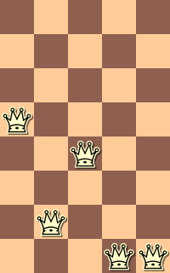
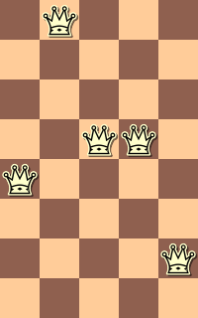

Genetic Algorithm Example – 8 Queens
To visualize this using state representations more amenable to humans…
32752411
24748552
Notes:
Here is that exact same process, but with the states visualized not just as strings, but with actual queens on the board.

Slide 37
Genetic Algorithm Example – 8 Queens
We cut the states around the pivot point…
32752411
24748552
Notes:
So what we mean by splitting the strings up is again, taking the front half of one and the back half of the other and swapping them around.

Slide 38
Genetic Algorithm Example – 8 Queens
Swap the representations before the pivot point…
32752411
24748552
Notes:
So what we mean by splitting the strings up is again, taking the front half of one and the back half of the other and swapping them around.

Slide 39
Genetic Algorithm Example – 8 Queens
And there you go! Two brand new board states! BUT WE’RE NOT DONE!
24752411
32752411
24748552
32748552
Notes:
Netting us these two completely new states!

Slide 40
Genetic Algorithm Example – 8 Queens
Step 5: Randomly Mutate the Offspring
Each gene has a 10% chance of changing
(i.e. each character has a chance of being replaced by a different random number from 1 to 8).
24748552
32748552
32752411
24752411
24415411
24415124
32752124
32543213
Notes:
So, we talked about mutation briefly earlier. This is getting at the idea of children developing traits that are completely different from the traits of their parents. This can be useful for a number of reasons, such as avoiding local maximum/minimum.
There could be lots of different mutation strategies, but let’s just say here that each “gene” (i.e., each character has a chance of being replaced by a different random number fromo 1-8_

Slide 41
Genetic Algorithm Example – 8 Queens
Step 5: Randomly Mutate the Offspring
Each gene has a 10% chance of changing
(i.e. each character has a chance of being replaced by a different random number from 1 to 8).
24748552
32748552
32752411
24752411
24415411
24415124
32752124
32543213
Notes:
So, we can say that these are numbers that were selected.

Slide 42
Genetic Algorithm Example – 8 Queens
Step 5: Randomly Mutate the Offspring
Each gene has a 10% chance of changing
(i.e. each character has a chance of being replaced by a different random number from 1 to 8).
24748552
32748152
32752411
24752411
24415417
24415124
32252124
32543213
Notes:
Genetic algorithms are good at finding “useful blocks” e.g., patterns of queens that we like and we generally want to stick around.
But maybe even though those patterns are generally good, it’s sometimes possible that we might get ourselves in a local minimum e.g., a trap (()e.g., this pattern consistently nets us really high scores, but maybe it will actually NEVER get us a perfect score). Mutations are gentle ways to incorporate some genetic diversity. Generally good patterns will still be found and have high weight and thus high chance to continue on to the next generation, but there’s also this slight variance that gets introduced to help explore other aspects of that state space landscape.

Slide 43
Genetic Algorithm Example – 8 Queens
Step 6: Replace the population with its offspring.
24748552
32748152
32752411
24752411
24415417
24415124
32252124
32543213
Notes:
And then, as is the wont of children, the final stage of the process is for the new generation to replace the old.

Slide 44
Genetic Algorithm Example – 8 Queens
The cycle of life continues anew: We check the fitness function results of these guys, see that none are solutions, and so we begin the process again!
32748152
24752411
24415417
32252124
Notes:
We treat the new generation as the current working population and the cycle begins anew. We’d run all of these through out fitness functrion In hopes that one is a solution. And if none of them are, then we do the process again.

Slide 45
Genetic Algorithms
As you might imagine…
How you choose to represent the state, and how you define your fitness function, has a huge impact on the results.
In general, genetic algorithms are good for optimization problems, and finding “useful blocks” or patterns of state.
Notes:
Genetic algorithms are good at finding “useful blocks” e.g., patterns of queens that we like and we generally want to stick around.

Slide 46
Genetic Algorithms – Fun Example
Here is a fun example of watching a genetic algorithm make cool cars!
https://rednuht.org/genetic_cars_2/
Notes:
This is kind of a mesmerizing thing to have going on in the background. It’s watching a genetic algorithm produce better and better cars!

